Slide 1
CORBA
The Common Object Request Broker Architecture (CORBA) is a standard architecture for a distributed objects system.
CORBA is designed to allow distributed objects to interoperate in a heterogeneous environment, where objects can be implemented in different programming language and/or deployed on different platforms
CORBA is not itself a distributed objects facility; instead, it is a set of protocols.

Slide 2
CORBA
A distributed object facility which adhere to these protocols is said to be CORBA- compliant, and the distributed objects that the facility support can interoperate with objects supported by other CORBA-compliant facilities.
CORBA is a very rich set of protocols.
We will focus on the key concepts of CORBA related to the distributed objects paradigm.
We will also study a facility based on CORBA: the Java IDL.

Slide 3
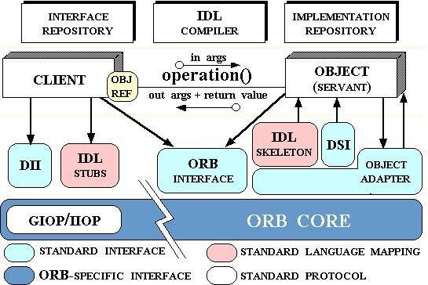
CORBA Architecture and Workflow
Architecture
Basic Workflow
naming lookup
naming service
object client
object implementation
st
ub
skel
eton
ORB
ORB
network
network
operating system
operating
system
logical data flow physical data flow

Slide 4

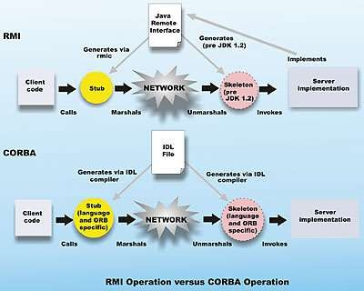
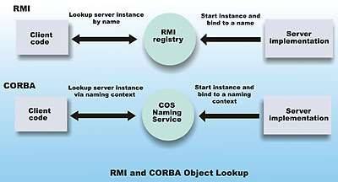
CORBA vs RMI
CORBA differs from the architecture of Java RMI in one significant aspect:
RMI is a proprietary facility developed by Sun MicroSystems, Inc., and supports objects written in the Java programming language only.
CORBA is an architecture that was developed by the Object Management Group (OMG), an industrial consortium.

Slide 5
CORBA vs RMI

Slide 6
CORBA vs RMI

Slide 7
CORBA Object Interface
A distributed object is defined using a software file similar to the remote interface file in Java RMI.
Since CORBA is language independent, the interface is defined using a universal language with a distinct syntax, known as the CORBA Interface Definition Language (IDL).
The syntax of CORBA IDL is similar to Java and C++.
However, object defined in a CORBA IDL file can be implemented in a large number of diverse programming languages, including C, C++, Java, COBOL, Smalltalk, Ada, Lisp, Python, and IDLScript.

Slide 8
CORBA Object Interface
For each of these languages, OMG has a standardized mapping from CORBA IDL to the programming language.
This mapping helps - a compiler can be used to process a CORBA interface to generate the proxy files needed to interface with an object implementation or an object client written in any of the CORBA-compatible languages.
Mapping of OMG IDL Statements to C++
https://docs.oracle.com/cd/E13203_01/tuxedo/tux80/cref/member.htm

Slide 9
CORBA Addressing and Bindings Explained with an Industry Use Case
➢
Overview of CORBA (Common Object Request Broker Architecture)
CORBA is a middleware standard defined by the Object Management Group (OMG) for enabling distributed object-oriented communication across different platforms, programming languages, and networks.
It allows applications to communicate seamlessly, even if they are built using different technologies.
One of the critical aspects of CORBA is Addressing and Bindings, which define how clients locate and communicate with remote objects.

Slide 10
CORBA Addressing and Bindings Explained with an Industry Use Case
➢
CORBA Addressing and Bindings
Addressing in CORBA
Addressing in CORBA refers to how clients find and refer to remote objects within a distributed environment. CORBA uses Object References (IOR - Interoperable Object References) to uniquely identify objects in a network.
Types of Addressing in CORBA:
1. Direct Addressing (Explicit Reference)
- Clients obtain the object reference explicitly (e.g., from a naming service or configuration file).
- Example: Using an Interoperable Object Reference (IOR) stored in a string format.

Slide 11
CORBA Addressing and Bindings Explained with an Industry Use Case
2. Indirect Addressing (Using Services)
- Clients use a Naming Service or Trader Service to discover objects dynamically.
- Example: CORBA Naming Service provides hierarchical object registration and lookup.
3. Persistent Addressing
- Objects are stored persistently and retrieved when required.
- Example: Banking applications store a user’s account reference for future transactions.
4. Transient Addressing
- Object references exist only for the duration of the application's execution.
- Example: A video streaming service's session reference expires after logout.

Slide 12
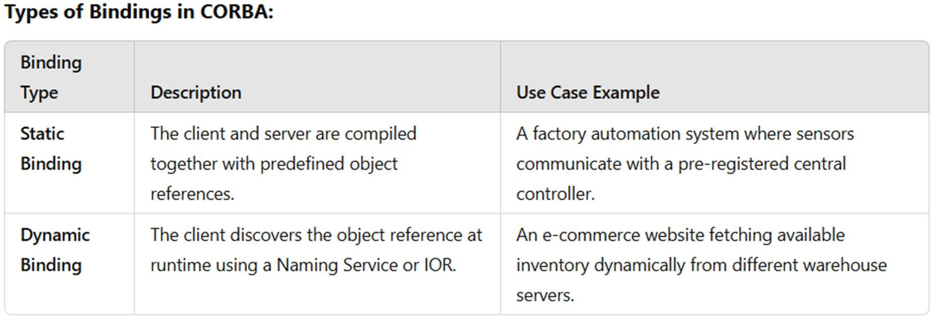
CORBA Addressing and Bindings Explained with an Industry Use Case
➢
Bindings in CORBA
Binding refers to how a client establishes a connection with a CORBA object before making a request.
Types of Bindings in CORBA:

Slide 13
CORBA Addressing and Bindings Explained with an Industry Use Case
➢
How Binding Works in CORBA:
1. Client gets an object reference (directly or via Naming Service).
2. The client invokes a method on the object reference, and CORBA handles communication.
3. CORBA’s ORB (Object Request Broker) marshals the request and sends it over the network.
4. The server’s ORB unmarshals the request, invokes the method, and sends the response back.

Slide 14
CORBA Addressing and Bindings Explained with an Industry Use Case
➢
Scenario:
Industry Use Case: CORBA in Banking Transactions
A global banking system needs to handle secure transactions between branches worldwide. The system requires:
- Interoperability (different banking software stacks communicate).
- Scalability (millions of customers and transactions).
- Security (transactions must be encrypted and reliable).
How CORBA Addressing and Binding Help in Banking Transactions:
1. Addressing:
- Each banking server has a unique object reference for customer accounts.
- The CORBA Naming Service allows clients (banking applications) to find account objects dynamically.
- The system uses persistent addressing to ensure that an account reference remains valid across sessions.

Slide 15
CORBA Addressing and Bindings Explained with an Industry Use Case
Binding:
- When a customer initiates a transaction, the banking application dynamically binds to the bank’s transaction- processing service.
- The Interoperable Object Reference (IOR) ensures secure communication with the correct branch.
- The client ORB and server ORB communicate securely to process the transaction.
Process Flow:
1. The user logs into the banking portal (client).
2. The client application queries the CORBA Naming Service to locate the account service.
3. CORBA binds dynamically to the correct banking server.
4. The transaction is executed securely via ORB communication.
5. The server returns the result, confirming success or failure.

Slide 16
CORBA Addressing and Bindings Explained with an Industry Use Case
Benefits in the Banking System:
Seamless Communication between different banking software stacks.
Scalability to handle millions of transactions per second.
Security via encrypted communication.
Fault Tolerance by using CORBA’s built-in load balancing and failover mechanisms.
Conclusion
CORBA’s addressing and bindings provide a robust mechanism for distributed applications to communicate seamlessly.
Industries like banking, telecommunications, and aerospace use CORBA to handle complex, cross-platform communication.

Slide 17

Cross-language CORBA application
object implementation written in C++
object client written in Java
stub in Java generated by compiling the CO RBA object inte rface
skeleton in C++ generated by compiling the CO RBA object
interface
ORB written in Java
ORB written in C++

Slide 18
Inter-ORB Protocols
To allow ORBs to be interoperable, the OMG(Object Management Group) specified a protocol known as the General Inter-ORB Protocol (GIOP), a specification which “provides a general framework for protocols to be built on top of specific transport layers.”
A special case of the protocol is the Inter-ORB Protocol (IIOP), which is the GIOP applied to the TCP/IP transport layer.

Slide 19
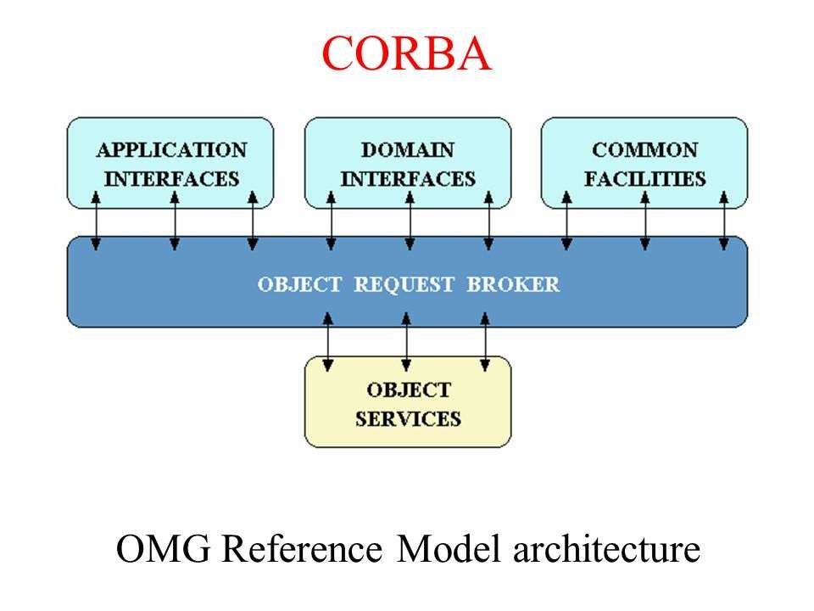

Slide 20
Inter-ORB Protocols
The IIOP specification includes the following elements:
Transport management requirements specifies the connection and disconnection requirements, and the roles for the object client and object server in making and unmaking connections.
Definition of common data representation: a coding scheme for marshalling and unmarshalling data of each IDL data type
Message formats: different types of message format are defined.
The messages allow clients to send requests to object servers and receive replies.
A client uses a Request message to invoke a method declared in a CORBA interface for an object and receives a reply message from the server.

Slide 21
Object Bus
An ORB which adheres to the specifications of the IIOP may interoperate with any other IIOP-compliant ORBs over the Internet.
This gives rise to the term “object bus”, where the Internet is seen as a bus that interconnects CORBA objects.
There are a large number of proprietary as well as experimental ORBs available:
CORBA
object
CORBA
object
CORBA
object
 | ORB |  |  | ORB |  | ... | ORB
 |  |  |  |  |  |  |  | The Internet

Slide 22
Object Bus
(See CORBA Product Profiles, http://www.puder.org/corba/matrix/)
Orbix IONA
Borland Visibroker
PrismTech’s OpenFusion
Web Logic Enterprise from BEA
Ada Broker from ENST
Free ORB
CORBA
object
CORBA
object
CORBA
object
 | ORB |  |  | ORB |  | ... | ORB
 |  |  |  |  |  |  |  | The Internet

Slide 23
Object Servers, Clients and Reference
As in Java RMI, a CORBA distributed object is exported by an object server, similar to the object server in RMI.
An object client retrieves a reference to a distributed object from a naming or directory service, to be described, and invokes the methods of the distributed object.
As in Java RMI, a CORBA distributed object is located using an object reference. Since CORBA is language-independent, a CORBA object reference is an abstract entity mapped to a language-specific object reference by an ORB, in a representation chosen by the developer of the ORB.
For interoperability, OMG specifies a protocol for the abstract CORBA object reference object, known as the Interoperable Object Reference (IOR) protocol.

Slide 24
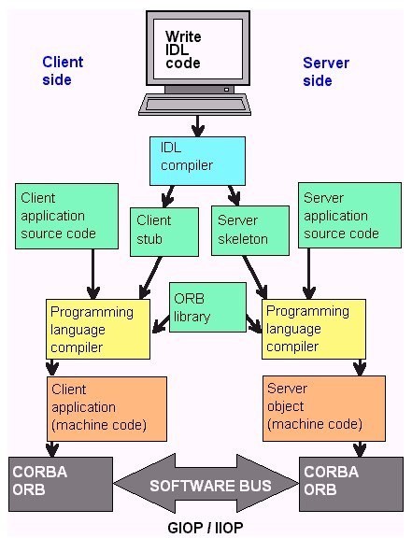
CORBA

Slide 25
Interoperable Object Reference (IOR)
An ORB compatible with the IOR protocol will allow an object reference to be registered with and retrieved from any IOR-compliant directory service.
CORBA object references represented in this protocol are called Interoperable Object References (IORs).
An IOR is a string that contains encoding for the following information:
The type of the object.
The host where the object can be found.
The port number of the server for that object.
An object key, a string of bytes identifying the object.
The object key is used by an object server to locate the object.

Slide 26
Interoperable Object Reference (IOR)
The following is an example of the string representation of an IOR [5]:
IOR:000000000000000d49444c3a677269643a312e300000000000000001000000000000004c000100000000001 5756c472612e6475626c696e2e696f6e612e696500000963000000283a5c756c7472612e6475626c696e2e696f6e6
12e69653a677269643a303a3a49523a67726964003a
The representation consists of the character prefix “IOR:” followed by a series of hexadecimal numeric characters, each character representing 4 bits of binary data in the IOR.

Slide 27
CORBA Naming Service
CORBA specifies a generic directory service.
The Naming Service serves as a directory for CORBA objects, and, as such, is platform independent and programming language independent.
The Naming Service permits ORB-based clients to obtain references to objects they wish to use.
It allows names to be associated with object references.
Clients may query a naming service using a predetermined name to obtain the associated object reference.

Slide 28
CORBA Naming Service
To export a distributed object, a CORBA object server contacts a Naming Service to bind a symbolic name to the object
The Naming Service maintains a database of names and the objects associated with them.
To obtain a reference to the object, an object client requests the Naming Service to look up the object associated with the name
(This is known as resolving the object name.)

Slide 29
CORBA Naming Service
The API for the Naming Service is specified in interfaces defined in IDL, and includes methods that allow servers to bind names
naming context₁
to objects and clients to resolve those names.
To be as general as possible, the CORBA object naming scheme is necessary complex.
Since the name space is universal, a standard naming hierarchy is defined in a manner similar to the naming hierarchy in
...
naming context
...
naming context2
1
...
naming context₁
naming context₁
object name₁
...
object name_{n}
a file directory

Slide 30
CORBA Naming Context
A naming context correspond to a folder or directory in a file hierarchy, while object names corresponds to a file.
The full name of an object, including all the associated naming contexts, is known as a compound name.
The first component of a compound name gives the name of a naming context, in which the second component is accessed.
This process continues until the last component of the compound name has been reached.

Slide 31
CORBA Naming Context
Naming contexts and name bindings are created using methods provided in the Naming Service interface.
CORBA Object Name: The syntax for an object name is as follows:
<naming context > …<naming context><object name>
where the sequence of naming contexts leads to the object name.

Slide 32
Example of a naming hierarchy
https://aws.amazon.com/api-gateway https://aws.amazon.com/api-gateway/pricing/ https://aws.amazon.com/api-gateway/features/
As shown, an object representing the men’s clothing department is named store.clothing.men, where store and clothing are naming contexts, and men is an object name.
The Interoperable Naming Service (INS) is a URL-based naming system based on the CORBA Naming Service, it allows applications to share a common initial naming context and provide a URL to access a CORBA object.
store
Appliances ...
clothing
...
women men television

Slide 33
CORBA Object Services
CORBA specify services commonly needed in distributed applications, some of which are:
Naming Service:
Concurrency Service:
Event Service: for event synchronization;
Logging Service: for event logging;
Scheduling Service: for event scheduling;
Security Service: for security management;
Trading Service: for locating a service by the type (instead of by name);

Slide 34
CORBA Object Services
CORBA specify services commonly needed in distributed applications, some of which are:
Time Service: a service for time-related events;
Notification Service: for events notification;
Object Transaction Service: for transactional processing.
Each service is defined in a standard IDL that can be implemented by a developer of the service object, and whose methods can be invoked by a CORBA client.
A First CORBA Application
https://docs.oracle.com/cd/F49540_01/DOC/java.815/a64683/corba3.htm

Slide 35
Object Adapters
In the basic architecture of CORBA, the implementation of a distributed object interfaces with the skeleton to interact with the stub on the object client side.
As the architecture evolved, a software component in addition to the skeleton was needed on the server side: an object adapter.
An object adapter simplifies the responsibilities of an ORB by assisting an ORB in delivering a client request to an object implementation.
When an ORB receives a client’s request, it locates the object adapter associated with the object and forwards the request to the adapter.
distributed object implementation
object adapter
ORB

Slide 36
Object Adapters
The adapter interacts with the object implementation’s skeleton, which performs data marshalling and invoke the appropriate method in the object.
There are different types of CORBA object adapters.
The Portable Object Adapter, or POA, is a particular type of object adapter
that is defined by the CORBA specification.
distributed object implementation
An object adapter that is a POA allows an object implementation to function with different ORBs, hence the word portable.
object adapter
ORB

Slide 37
Portable Object Adapters
Portable Object Adapter (POA) in CORBA: Examples & Exercises
1. What is the Portable Object Adapter (POA)?
The Portable Object Adapter (POA) is a CORBA component that manages object implementations and request dispatching.
It allows developers to control object activation, request handling, and object lifespan.

Slide 38
Portable Object Adapters
POA Features & Lifecycle
Key Features of POA:
- Persistent and transient objects (controls object lifecycle).
- Multi-threading and request processing policies (handles multiple requests efficiently).
- Object Activation Policies (implicit vs. explicit activation).
- Servant Managers (allows lazy object creation).
POA Lifecycle in CORBA:
1. Create a POA (from the ORB).
2. Create a servant (implementation of the CORBA object).
3. Activate the servant (bind to an object reference).
4. Process requests (handle client calls).
5. Deactivate servant (cleanup).

Slide 39
Portable Object Adapters
Example: Implementing POA in CORBA
Let's implement a simple CORBA server-client application using POA.
Step 1: Define the IDL (Interface Definition Language)
module Banking {
interface Account {
float getBalance();
};
};
This defines a `Banking::Account` interface that provides a `getBalance()` method.

Slide 40
Java IDL – Java’s CORBA Facility
IDL is part of the Java 2 Platform, Standard Edition (J2SE).
The Java IDL facility includes a CORBA Object Request Broker (ORB), an IDL-to-Java compiler, and a subset of CORBA standard services.
In addition to the Java IDL, Java provides a number of CORBA-compliant facilities, including RMI over IIOP, which allows a CORBA application to be written using the RMI syntax and semantics.
Key Java IDL Packages
package org.omg.CORBA – contains interfaces and classes which provides the mapping of the OMG CORBA APIs to the Java programming language
package org.omg.CosNaming - contains interfaces and classes which provides the naming service for Java IDL
org.omg.CORBA.ORB - contains interfaces and classes which provides APIs for the Object Request Broker.

Slide 41
Java IDL Tools
Java IDL provides a set of tools needed for developing a CORBA application:
idlj - the IDL-to-Java compiler (called idl2java in Java 1.2 and before)
orbd - a server process which provides Naming Service and other services
servertool – provides a command-line interface for application programmers to register/unregister an object, and startup/shutdown a server.
tnameserv – an olderTransient Java IDL Naming Service whose use is now discouraged.

Slide 42
A Java IDL Application example
Compiling the IDL file (using Java)
The IDL file should be placed in a directory dedicated to the application.
The file is compiled using the compiler idlj using a command as follows:
idlj -fall Hello.idl
The –fall command option is necessary for the compiler to generate all the files needed.
In general, the files can be found in a subdirectory named <some name>App when an interface file named <some name>.idl is compiled.

Slide 43
A Java IDL Application example
If the compilation is successful, the following files can be found in a HelloApp subdirectory:
HelloOperations.java
Hello.java
HelloHelper.java
HelloHolder.java
_HelloStub.java
HelloPOA.java
The CORBA Interface file Hello.idl
module HelloApp
{
interface Hello
{
string sayHello();
oneway void shutdown();
};
08. };
These files require no modifications.

Slide 44
The *Operations.java file
There is a file HelloOperations.java found in HelloApp/ after you compiled using idlj
It is known as a Java operations interface in general
It is a Java interface file that is equivalent to the CORBA IDL interface file (Hello.idl)
You should look at this file to make sure that the method signatures correspond to what you expect.
HelloApp/HelloOperations.java : The file contains the methods specified in the original IDL file: in this case the methods sayHello( ) and shutdown().
HelloApp/Hello.java: The signature interface file combines the characteristics of the Java operations interface (HelloOperations.java) with the characteristics of the CORBA classes that it extends.
01. package HelloApp;
03. /**
* HelloApp/Hello.java
* Generated by the IDL-to-Java compiler (portable),
* version "3.1" from Hello.idl
*/
09. public interface Hello extends HelloOperations,
org.omg.CORBA.Object,
org.omg.CORBA.portable.IDLEntity
12. { …
13. } // interface Hello
01. package HelloApp;
04. /**
* HelloApp/HelloOperations.java
* Generated by the IDL-to-Java compiler (portable),
* version "3.1" from Hello.idl
*/
09.
public interface HelloOperations
{
String sayHello ();
void shutdown ();
} // interface HelloOperations

Slide 45
The *Operations.java file
HelloHelper.java, the Helper class:
The Java class HelloHelper provides auxiliary functionality needed to support a CORBA object in the context of the Java language.
In particular, a method, narrow, allows a CORBA object reference to be cast to its corresponding type in Java, so that a CORBA object may be operated on using syntax for Java object.
HelloHolder.java, the Holder class:
The Java class called HelloHolder holds (contains) a reference to an object that implements the Hello interface.
The class is used to handle an out or an inout parameter in IDL in Java syntax
( In IDL, a parameter may be declared to be out if it is an output argument, and inout if the parameter contains an input value as well as carries an output value.)
_HelloStub.java:
The Java class HelloStub is the stub file, the client-side proxy, which interfaces with the client object.
It extends org.omg.CORBA.portable.ObjectImpl and implements the Hello.java interface.

Slide 46
The *Operations.java file
HelloPOA.java, the server skeleton:
The Java class HelloImplPOA is the skeleton, the server-side proxy, combined with the portable object adapter.
It extends org.omg.PortableServer.Servant, and implements the InvokeHandler interface and the HelloOperations interface.
Server Side classes:
On the server side, two classes need to be provided: the servant and the server.
The servant, HelloImpl, is the implementation of the Hello IDL interface; each Hello object is an instantiation of this class.

Slide 47
The Application
The Servant - HelloApp/HelloImpl.java
// The servant -- object implementation -- for the Hello example. Note that this is a subclass of HelloPOA, whose source file is generated from the
// compilation of Hello.idl using j2idl.
import HelloApp.*;
import org.omg.CosNaming.*; import java.util.Properties; …
class HelloImpl extends HelloPOA { private ORB orb;
public void setORB(ORB orb_val) {
orb = orb_val;
}
// implement sayHello() method
public String sayHello() { return "\nHello world !!\n";
}
// implement shutdown() method
public void shutdown() { orb.shutdown(false);
}
} //end class
The Servant - HelloApp/HelloServer.java
public class HelloServer {
public static void main(String args[]) { try{
// create and initialize the ORB
ORB orb = ORB.init(args, null);
// get reference to rootpoa & activate the POAManager POA rootpoa =
(POA)orb.resolve_initial_references("RootPOA");
rootpoa.the_POAManager().activate();
// create servant and register it with the ORB HelloImpl helloImpl = new HelloImpl(); helloImpl.setORB(orb);
// get object reference from the servant org.omg.CORBA.Object ref =
rootpoa.servant_to_reference(helloImpl);
// and cast the reference to a CORBA reference Hello href = HelloHelper.narrow(ref);

Slide 48
The Application
The Servant - HelloApp/HelloServer.java
// and cast the reference to a CORBA reference Hello href = HelloHelper.narrow(ref);
// get the root naming context
// NameService invokes the transient name service
org.omg.CORBA.Object objRef = orb.resolve_initial_references("NameService");
// Use NamingContextExt, which is part of the
// Interoperable Naming Service (INS) specification. NamingContextExt ncRef = NamingContextExtHelper.narrow(objRef);
// bind the Object Reference in Naming
String name = "Hello";
NameComponent path[] = ncRef.to_name( name ); ncRef.rebind(path, href);
System.out.println ("HelloServer ready and waiting ...");
// wait for invocations from clients orb.run();

Slide 49
The Object Client Application
A client program can be a Java application, an applet, or a servlet.
The client code is responsible for creating and initializing the ORB, looking up the object using the Interoperable Naming Service, invoking the narrow method of the Helper object to cast the object reference to a reference to a Hello object implementation, and invoking remote methods using the reference.
The object’s sayHello method is invoked to receive a string, and the object’s shutdown method is invoked to deactivate the service.
The Servant - HelloApp/HelloClient.java
// A sample object client application. import HelloApp.*;
import org.omg.CosNaming.*; … public class HelloClient{
static Hello helloImpl;
public static void main(String args[]){ try{
ORB orb = ORB.init(args, null); org.omg.CORBA.Object objRef =
orb.resolve_initial_references("NameService"); NamingContextExt ncRef =
NamingContextExtHelper.narrow(objRef); helloImpl = HelloHelper.narrow(ncRef.resolve_str(“Hello”)); System.out.println(helloImpl.sayHello()); helloImpl.shutdown();

Slide 50
Compiling and Running a Java IDL application
Create and compile the Hello.idl file on the server machine: idlj -fall Hello.idl
Copy the directory containing Hello.idl (including the subdirectory generated by idlj) to the client machine.
In the HelloApp directory on the client machine: create HelloClient.java. Compile the
*.java files, including the stubs and skeletons (which are in the directory HelloApp): javac *.java HelloApp/*.java
In the HelloApp directory on the server machine:
Create HelloServer.java. Compile the .java files:
javac *.java HelloApp/*.java
On the server machine: Start the Java Object Request Broker Daemon, orbd, which includes a Naming Service.
To do this on Unix: orbd -ORBInitialPort 1050 -ORBInitialHost servermachinename& To do this on Windows:
start orbd -ORBInitialPort 1050 -ORBInitialHost servermachinename

Slide 51
Compiling and Running a Java IDL application
On the server machine, start the Hello server, as follows:
java HelloServer –ORBInitialHost <nameserver host name> -ORBInitialPort 1050
On the client machine, run the Hello application client. From a DOS prompt or shell, type: java HelloClient -ORBInitialHost nameserverhost -ORBInitialPort 1050
all on one line.
Note that nameserverhost is the host on which the IDL name server is running. In this case, it is the server machine.
Kill or stop orbd when finished. The name server will continue to wait for invocations until it is explicitly stopped.
Stop the object server

Slide 52
RMI (Remote Method Invocation)
The RMI (Remote Method Invocation) is an API that provides a mechanism to create distributed application in java.
The RMI allows an object to invoke methods on an object running in another JVM.
The RMI provides remote communication between the applications using two objects stub and skeleton.
Understanding stub and skeleton
RMI uses stub and skeleton object for communication with the remote object.
A remote object is an object whose method can be invoked from another JVM.
Let's understand the stub and skeleton objects:

Slide 53
RMI (Remote Method Invocation)
Stub
The stub is an object, acts as a gateway for the client side.
All the outgoing requests are routed through it.
It resides at the client side and represents the remote object.
When the caller invokes method on the stub object, it does the following tasks:
It initiates a connection with remote Virtual Machine (JVM),
It writes and transmits (marshals) the parameters to the remote Virtual Machine (JVM),
It waits for the result
It reads (unmarshals) the return value or exception, and
It finally, returns the value to the caller.

Slide 54
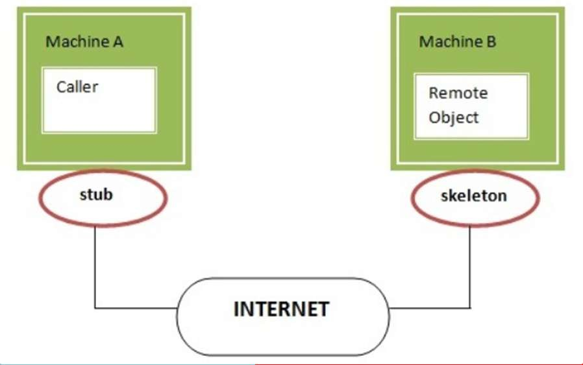
RMI (Remote Method Invocation)
Skeleton
The skeleton is an object, acts as a gateway for the server side object.
All the incoming requests are routed through it.
When the skeleton receives the incoming request, it does the following tasks:
It reads the parameter for the remote method
It invokes the method on the actual remote object, and
It writes and transmits (marshals) the result to the caller.

Slide 55
RMI (Remote Method Invocation)
Java RMI Example
The is given the 6 steps to write the RMI program.
Create the remote interface
Provide the implementation of the remote interface
Compile the implementation class and create the stub and skeleton objects using the rmic tool
Start the registry service by rmiregistry tool
Create and start the remote application
Create and start the client application

Slide 56
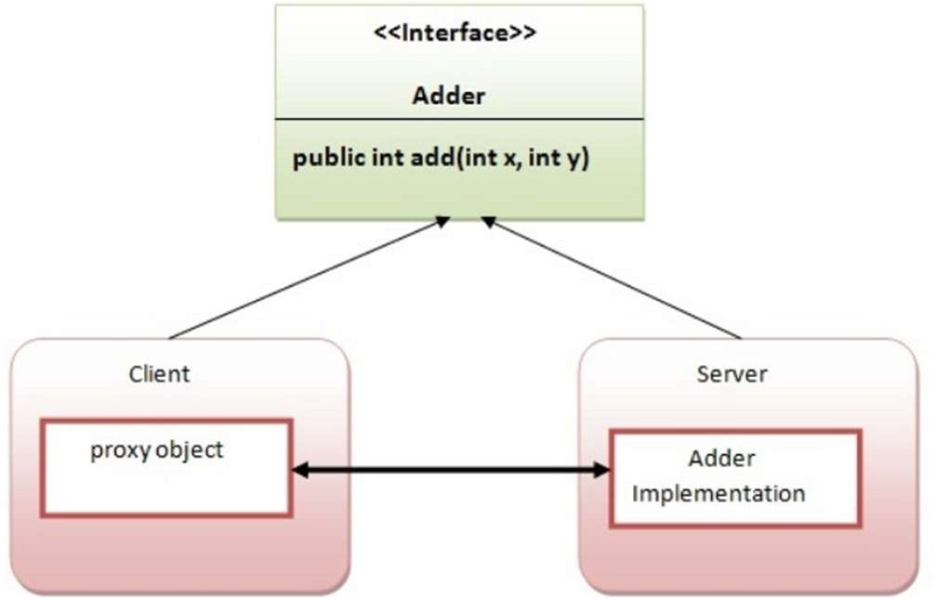
RMI (Remote Method Invocation)
RMI Example
In this example, we have followed all the 6 steps to create and run the rmi application.
The client application need only two files, remote interface and client application.
In the rmi application, both client and server interacts with the remote interface.
The client application invokes methods on the proxy object, RMI sends the request to the remote JVM.
The return value is sent back to the proxy object and then to the client application.

Slide 57
RMI (Remote Method Invocation)
1) create the remote interface
For creating the remote interface, extend the Remote interface and declare the RemoteException with all the methods of the remote interface.
Here, we are creating a remote interface that extends the Remote interface. There is only one method named add() and it declares RemoteException. import java.rmi.*;
public interface Adder extends Remote{
public int add(int x,int y)throws RemoteException;
}

Slide 58
RMI (Remote Method Invocation)
2) Provide the implementation of the remote interface
Now provide the implementation of the remote interface.
For providing the implementation of the Remote interface, we need to
Either extend the UnicastRemoteObject class,
or use the exportObject() method of the UnicastRemoteObject class
In case, you extend the UnicastRemoteObject class, you must RemoteException.
import java.rmi.*;
import java.rmi.server.*;
public class AdderRemote extends UnicastRemoteObject implements Adder{
AdderRemote()throws RemoteException{
super();
}
public int add(int x,int y){return x+y;}
}
define a constructor that declares

Slide 59
RMI (Remote Method Invocation)
3) create the stub and skeleton objects using the rmic tool.
Next step is to create stub and skeleton objects using the rmi compiler.
The rmic tool invokes the RMI compiler and creates stub and skeleton objects.
•
rmic AdderRemote
4) Start the registry service by the rmiregistry tool
Now start the registry service by using the rmiregistry tool.
If you don't specify the port number, it uses a default port number. In this example, we are using the port number 5000.
•
rmiregistry 5000

Slide 60
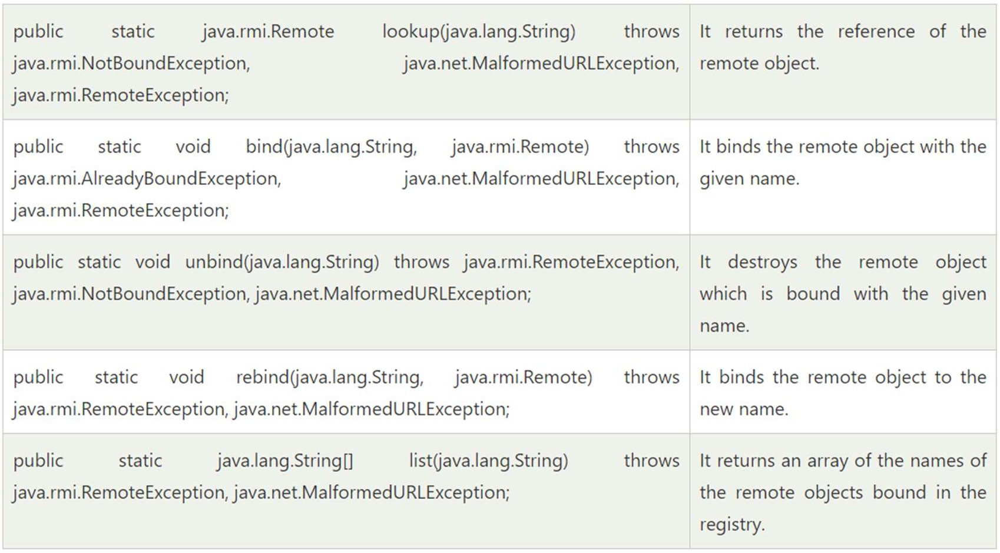
RMI (Remote Method Invocation)
5) Create and run the server application
Now rmi services need to be hosted in a server process.
The Naming class provides methods to get and store the remote object.
The Naming class provides 5 methods.

Slide 61
RMI (Remote Method Invocation)
In this example, we are binding the remote object by the name sonoo.
import java.rmi.*;
import java.rmi.registry.*;
public class MyServer{
public static void main(String args[]){
try{
Adder stub=new AdderRemote(); Naming.rebind("rmi://localhost:5000/sonoo",stub);
}catch(Exception e){System.out.println(e);}
}
}

Slide 62
RMI (Remote Method Invocation)
6) Create and run the client application
At the client we are getting the stub object by the lookup() method of the Naming class and invoking the method on this object.
In this example, we are running the server and client applications, in the same machine so we are using localhost.
If you want to access the remote object from another machine, change the localhost to the host name (or IP address) where the remote object is located.
import java.rmi.*;
public class MyClient{
public static void main(String args[]){
try{
Adder stub=(Adder)Naming.lookup("rmi://localh ost:5000/sonoo"); System.out.println(stub.add(34,4));
}catch(Exception e){}
}
}

Slide 63
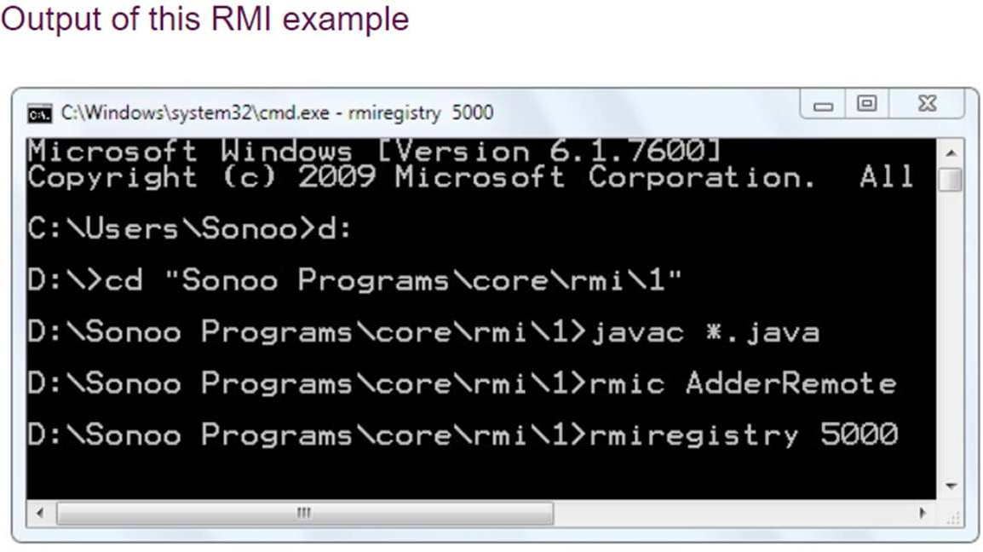
RMI (Remote Method Invocation)
For running this rmi example,
compile all the java files javac *.java
create stub and skeleton object by rmic tool rmic AdderRemote
start rmi registry in one command prompt rmiregistry 5000
start the server in another command prompt java MyServer
start the client application in another command prompt java MyClient

Slide 64
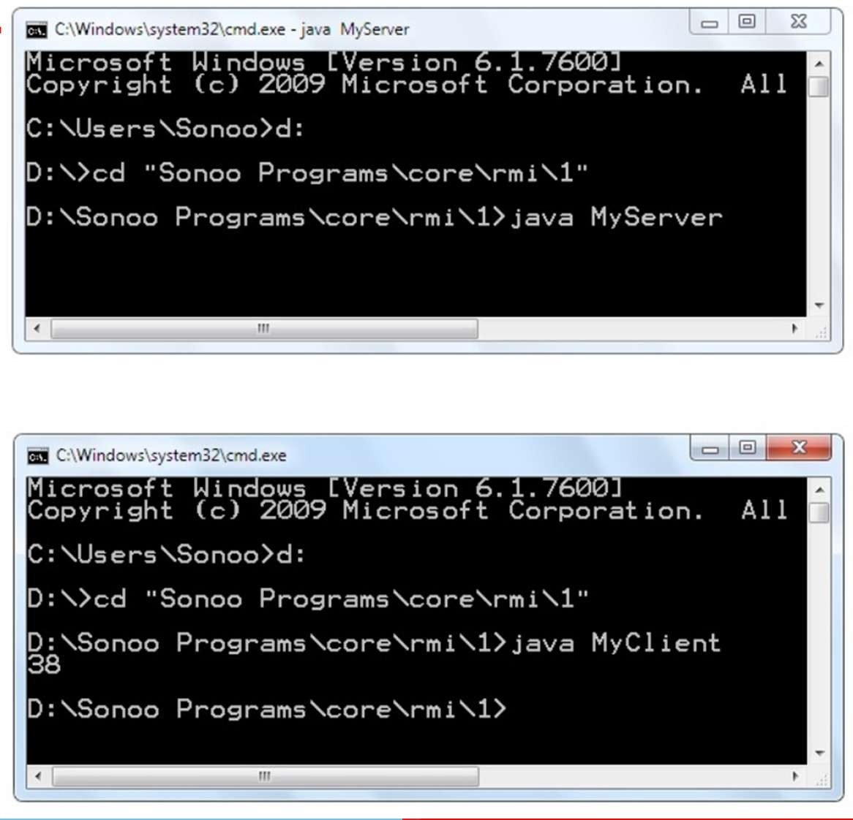
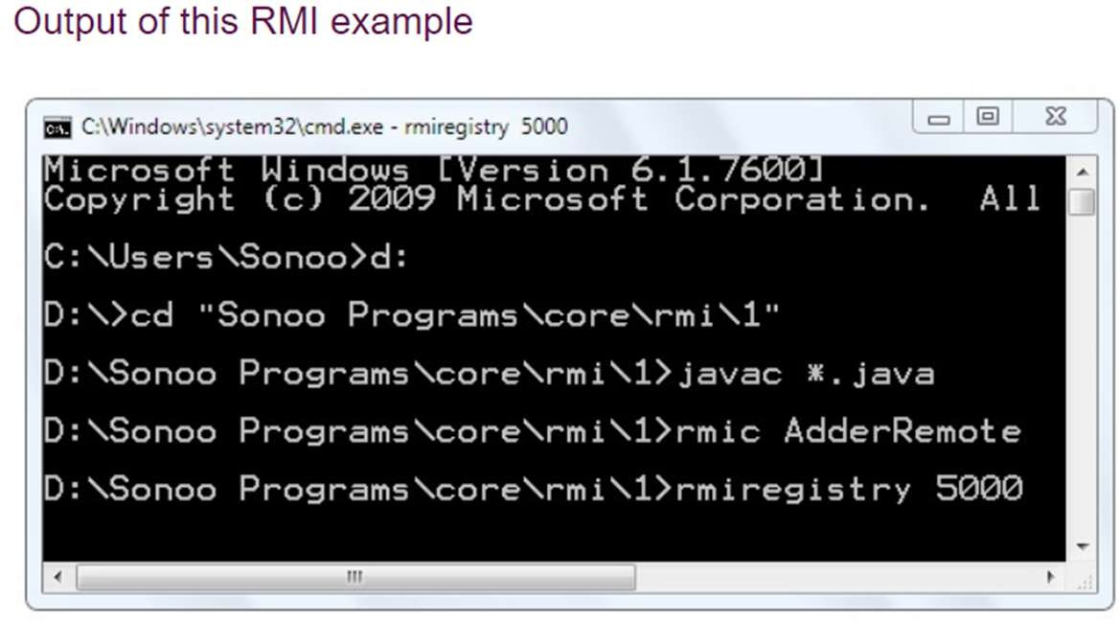
RMI (Remote Method Invocation)

Slide 65
Summary
The key topics introduced with CORBA are:
The basic CORBA architecture and its emphasis on object interoperability and platform independence
Object Request Broker (ORB) and its functionalities
The Inter-ORB Protocol (IIOP) and its significance
CORBA object reference and the Interoperable Object Reference (IOR) protocol
CORBA Naming Service and the Interoperable Naming Service (INS)
Standard CORBA object services and how they are provided.
Object adapters, portable object Adapters (POA) and their significance.
The key topics introduced with Java IDL are:
It is part of the Java TM 2 Platform, Standard Edition (J2SE)
Java packages are provided which contain interfaces and classes for CORBA support
Tools provided for developing a CORBA application include idlj (the IDL compiler) and orbd (the ORB and name server)
An example application Hello
Steps for compiling and running an application.
Client callback is achievable.
CORBA toolkits and Java RMI are comparable and alternative technologies that provide distributed objects. An application may be implemented using either technology. However, there are tradeoffs between the two.

